Slide 1
Weekly Meeting
5th October 2023

Slide 2
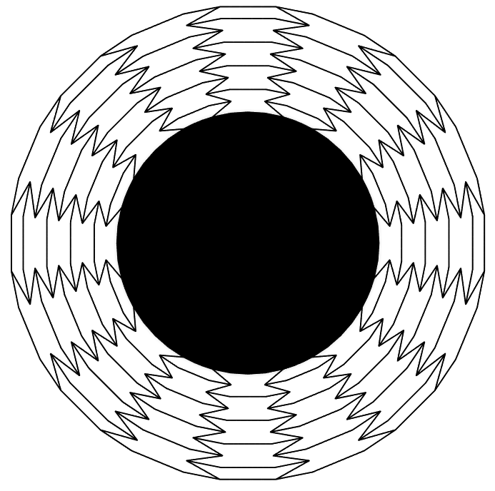
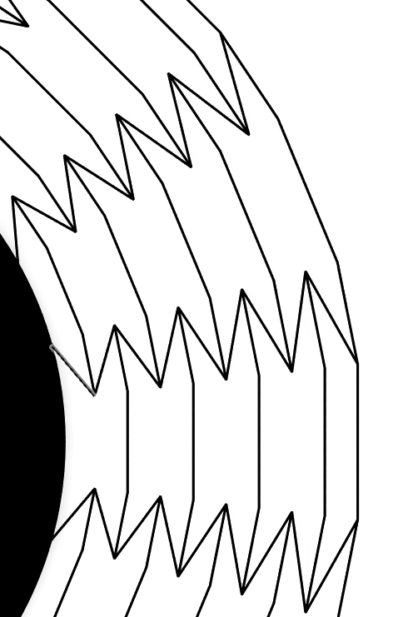
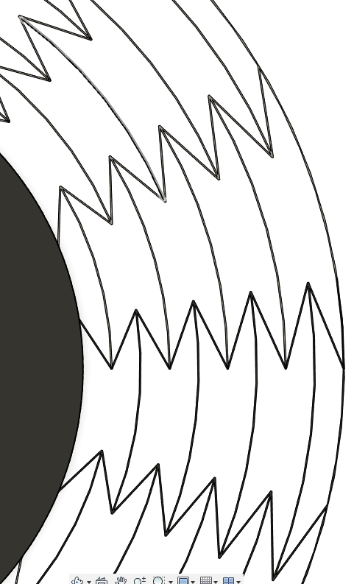
ADRG Straight
Fig: Degenerated mode shapes
Eigenfrequency = 6984Hz

Slide 3
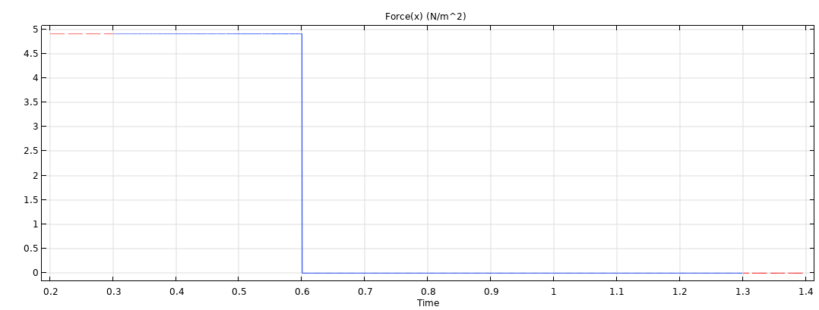
Time Dependent Study- Square Wave Input

Slide 4
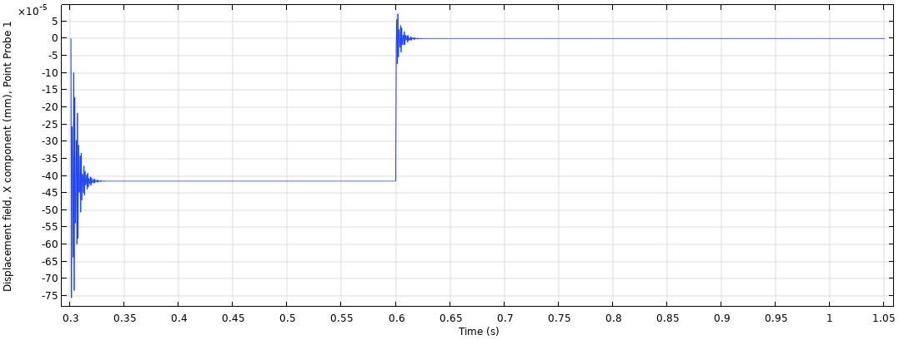
Time Dependent Study- Displacement

Slide 5
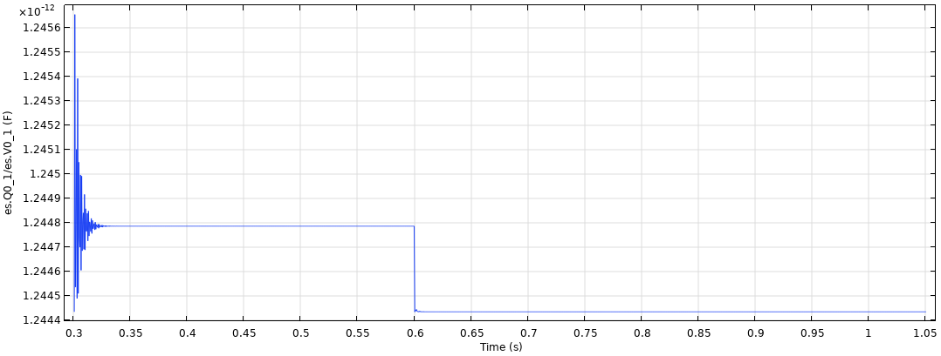
Time Dependent Study-Capacitance

Slide 7
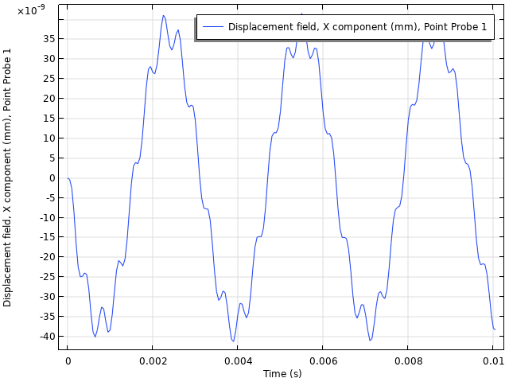
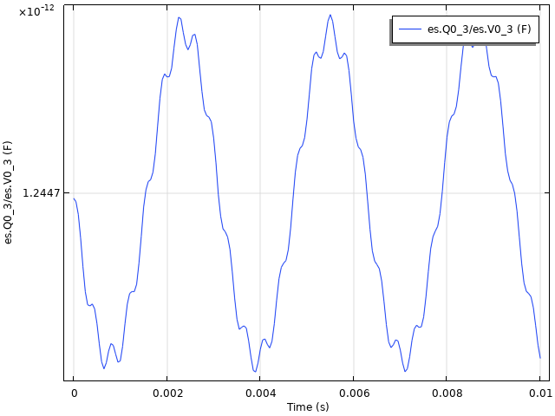
Sinusoidal Actuation at 2000 Hz

